Slide 1

Placement Management System
By Tejal Mahale
Student ID : EBEON0721395248 Batch Code : 5759

Slide 2
INTRODUCTION
The project named “Placement Management System”, a student/company information system is a window based application created in Java Spring Boot.
The project has been developed on the basis of “Placement Cell” being presently used in the University for storing and retrieving the information of students and companies who are registered in placement cell.
The Placement Cell maintains a large database of students wherein all the information of student including the personal records and the academic performance in terms of the marks and grades is stored and company information including resume of company and facilities it provide.
The software retrieves this data and displays as per the user requirement.

Slide 3
Project Overview
Our project explains about the Placement Management System. This project mainly explains the various actions related to placement related to students and recruiter. You can search various jobs and shuffle according to category.
I have developed this Application in Spring Boot, Spring Data JPA, Hibernate, Thymeleaf, & MySQL.
It’s a web-based projects so I have used HTML, CSS, JavaScript and Bootstrap also.

Slide 4
OBJECTIVE
objective of Placement Management System is to develop a student and company information system. Although such a project has a very wide scope, this project contains the most important part i.e. displaying the personal and academic information of a student and company.
The students and companies are also provided with the facility of editing some fields like username and password.
The project also allows a Data Base Administrator to enter the information of a student and company which is then stored in the corresponding tables in the main database .
He can also delete the student and company information after placement is over from the main database.

Slide 5
PLACEMENT MODULE
03
ADMIN MODULE
The admin is the placement officer who views the students details and company details and post the selected students list. Sending email to student for complete list of information for particular campus. Indication of hall ticket issued to candidates through mail. Login, View company details, View selected students details, Sending mail.
STUDENT MODULE
. In this module, creation of student input records about academic career from SSLC, HSC and all semester with facilities to modify the records and viewing changed records. The Student views the company details and verifies particular company details and provides valid details for registration
01
02
RECRUITER MODULE
The company enrolls themselves and they register their profile and their will marquee in the main page till their drive and view the student’s details and update their details. Login Company, registration, students details view

Slide 6
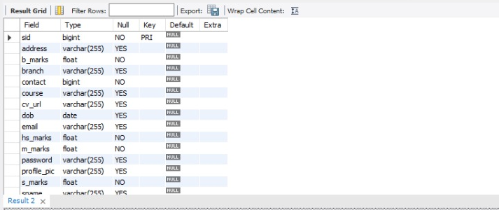
Data dictionary
Student Module :

Slide 7
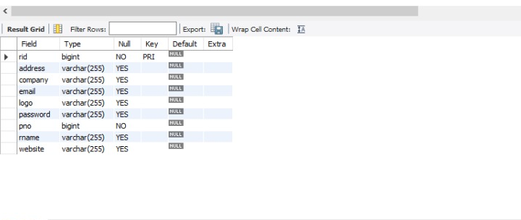
Data dictionary
Recruiter Module :

Slide 8
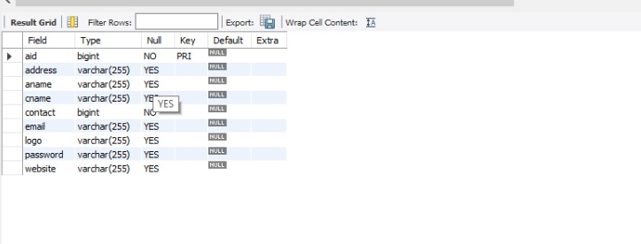
Data dictionary
Admin Module :

Slide 9
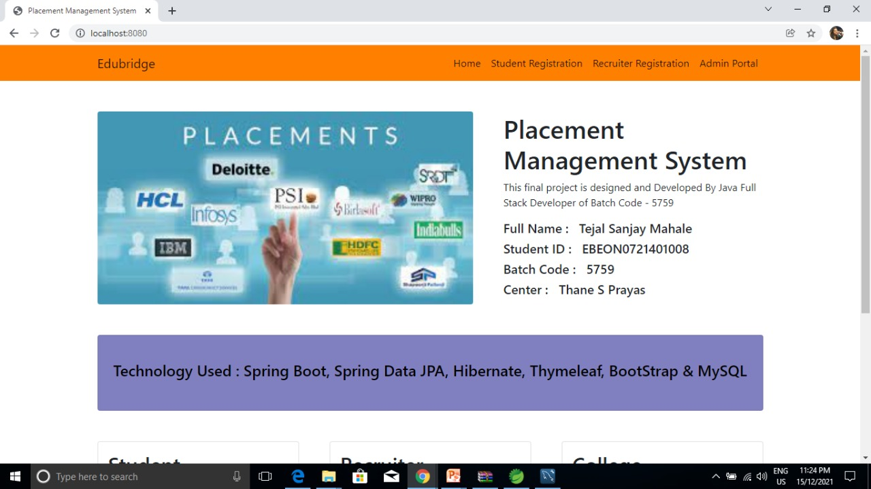
Screenshots
Home page :

Slide 10
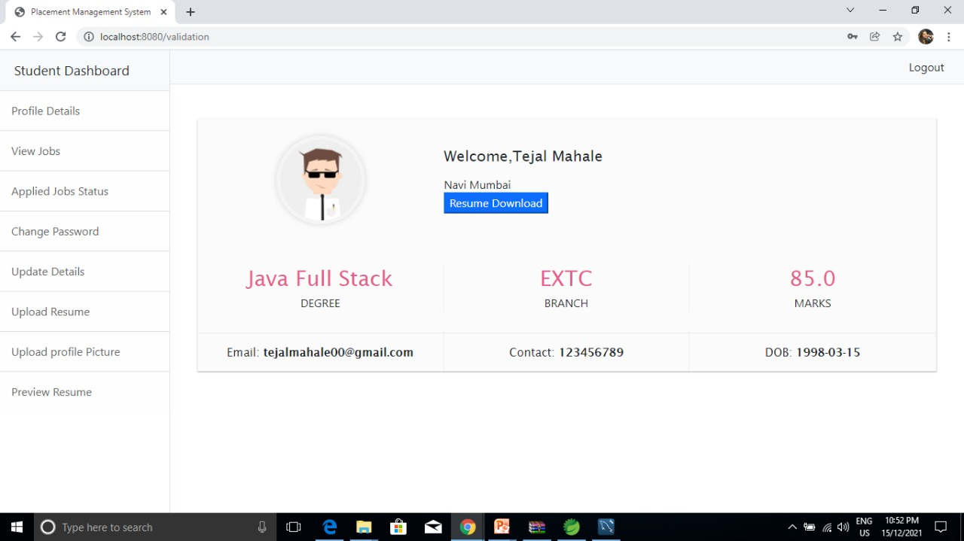
Screenshot
Student Dashboard Page :

Slide 11
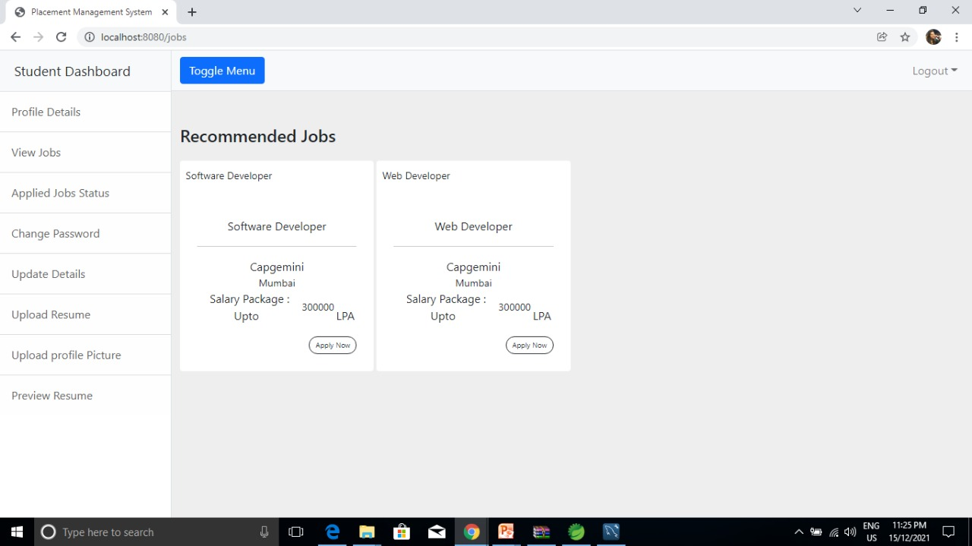
Screenshot
Student View Job Dashboard Page:

Slide 12
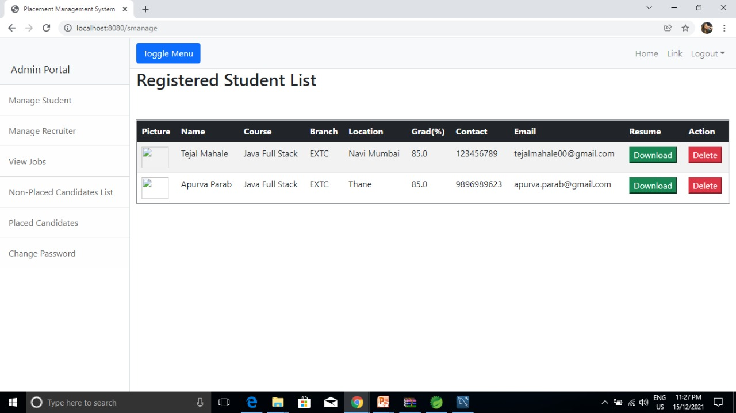
Screenshot
Admin Manage Student Dashboard Page:

Slide 13
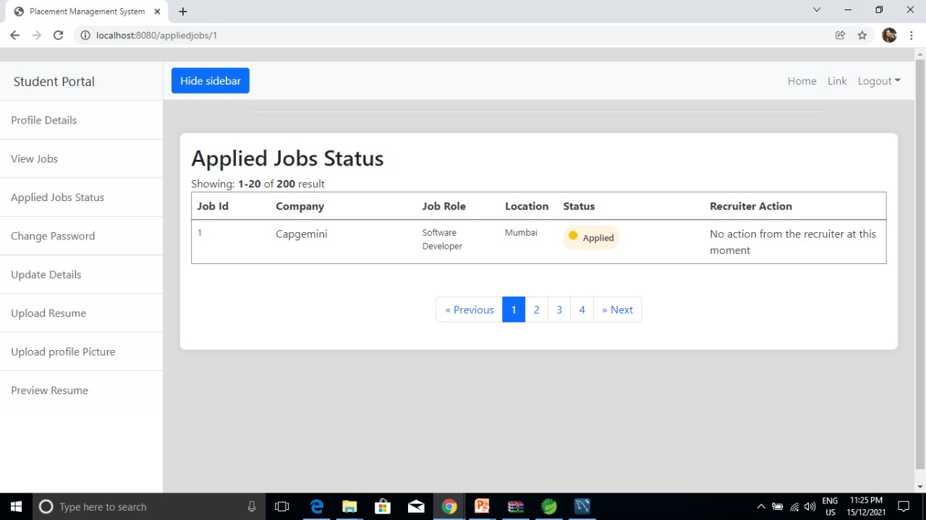
Screenshot
Student Applied Job Dashboard Page:

Slide 14
THANKS!

